Slide 1
CSE 575 Internship
Michael Smith

Slide 2

Where was I Interning at?
During this quarter, I was working for the company,
Geek Squad.
The position I was working is called an Advanced
Repair Agent.

Slide 3
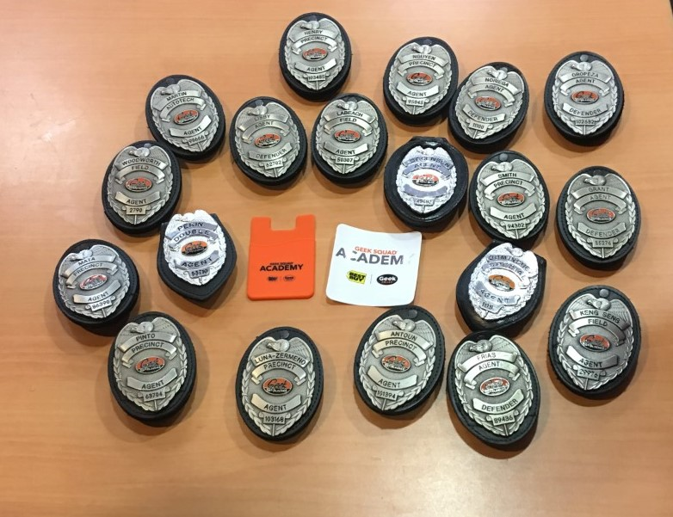
Background of Geek Squad
I quickly learned that this company is not as serious as I
originally expected.
It holds true to one of Best Buy’s company values, which
is “Have fun while being the best.”
Geek Squad has its own culture, which is important to all
who work for them.
In fact they have their own Geek Squad Culture App…
The core of this culture, is that we are all Geeks. Meaning
that we are all enthusiasts and love technology.
Geek is not an insult to us. It is a title we wear with honor.

Slide 4
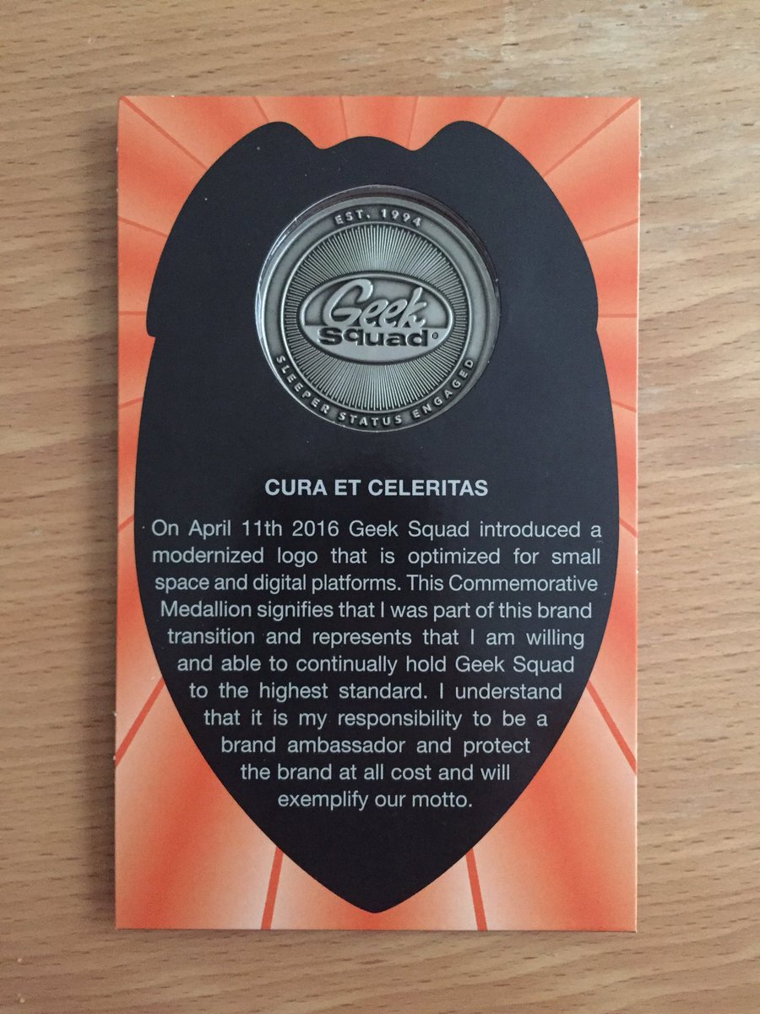
Cura Et Celeritas
This is Geek Squad’s Motto. It is Latin for “Accurately and Swiftly”
This holds true for every where in Geek Squad. We will always work to the fastest we can; however, we will never sacrifice a good effective repair for speed.

Slide 5

What does it mean to be an Advanced Repair Agent?
With my position, I was an enthusiast for computers.
This did not mean that I was only expected to know one
aspect. I was required to work in all: hardware, software,
troubleshooting, debugging and reporting.
My work also was beyond computers, I also had extensive
work in mobile devices as well, such as phones and tablets.

Slide 6
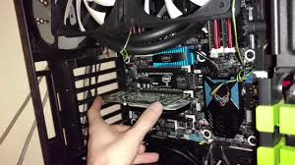
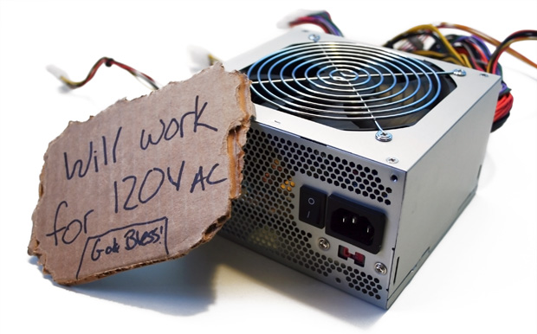
Hardware Experiences
During my training for the position, hardware was the
easiest one to pick up.
Having background with building computers, I quickly
excelled through simple tasks such as:
-Power supply replacements
-Graphics card installations
-Hard drive installations/replacements

Slide 7
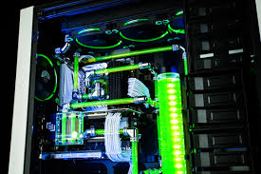
Hardware Experiences Continued..
My comfortability with hardware work quickly showed
to my management and we decided to expand upon
my work in hardware.
I started to handle more complex projects, such as:
-Processor Replacements,
-Fan/Air control
-Full PC rebuilds
-Working with clients on completely new builds
-Custom Liquid cooling

Slide 8
Hardware Experiences Continued..
My work with computer hardware
ranged from cheap basic hardware replacements
to full custom high-end gaming and engineering
stations.
My hardware experiences did not stop with just
computer hardware though.

Slide 9
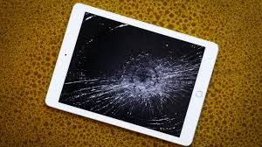
Hardware Experiences Continued..
I started wanting to learn how to work with mobile
devices as well.
However, I would quickly learn to regret this decision,
I still got extensive experience in repairs such as:
-Broken screen replacements on iPhone, Samsung,
iPad and other tablets
-Battery replacements
-Mobile camera replacements
-Home, volume control, and lock button replacements
My biggest take away is that mobile devices are fragile
and finicky. During my training I definitely broke things
while trying to replace others.

Slide 10

Hardware Experiences Continued..
The hardware was not always given to me and
the issue was already diagnosed.
Hardware troubleshooting is my specialty, in
fact my coworkers would leave it for me
specifically.
I was very good at simply applying a systematic
form of troubleshooting. Narrowing the issues
down by eliminating variables one at a time.

Slide 11
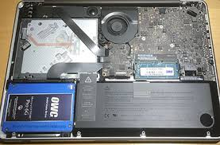
Hardware Experiences Continued..
For example:
Quite frequently in MacBook Pro models from late
2010 to late 2013 models, before they introduced
the retina display, there was an issue with there SATA
Cable that would connect from the hard drive to the
unit’s logic board.
The unit would power on and show an icon that means
that the boot device was missing. The tricky part was
this same icon can occur when the hard drive has crashed.
So I would take the drive out and plug it in with a SATA to
USB connection, and if the unit powered on correctly, then
I knew that the cable was bad.
However if this did not work, I would have to take a known
working hard drive and plug it into the original SATA cable.
If this worked, then the original hard drive failed, but if did
not work then the SATA cable is malfunctioning.

Slide 12

Hardware Experiences Continued..
My hardware experiences while working at Geek
Squad was quite extensive.
It taught me how to properly work with hardware,
such as properly grounding myself while working
with sensitive electronics. Or how important the
proper set of tools were when dealing with small
equipment in mobile devices.
As well as how to systematically troubleshoot
which easily translate into my program
debugging.
It is a skill set that I am grateful to have learned
and I successfully translated into my other work.

Slide 13

Software Experiences
At Geek Squad, we are only allowed to work on
commercial operating systems. Such as:
-Windows 7, 8/8.1, 10
-MacOS
-ChromeOS
-iOS
-Andriod
Since Linux is an open source, we are not able
to work on that OS.

Slide 14
Software Experiences continues..
Geek Squad has a specialty toolkit to work
on Windows.
The application is called MRI BDE Core
Application.
The application is developed within the
company, at our cooperate location.
Unfortunately since the application is a
Trade secret for Geek Squad, I am not
allowed to show the application in detail.
Other then two screen shots, that I got
approval to share since it doesn’t show
any information.

Slide 15
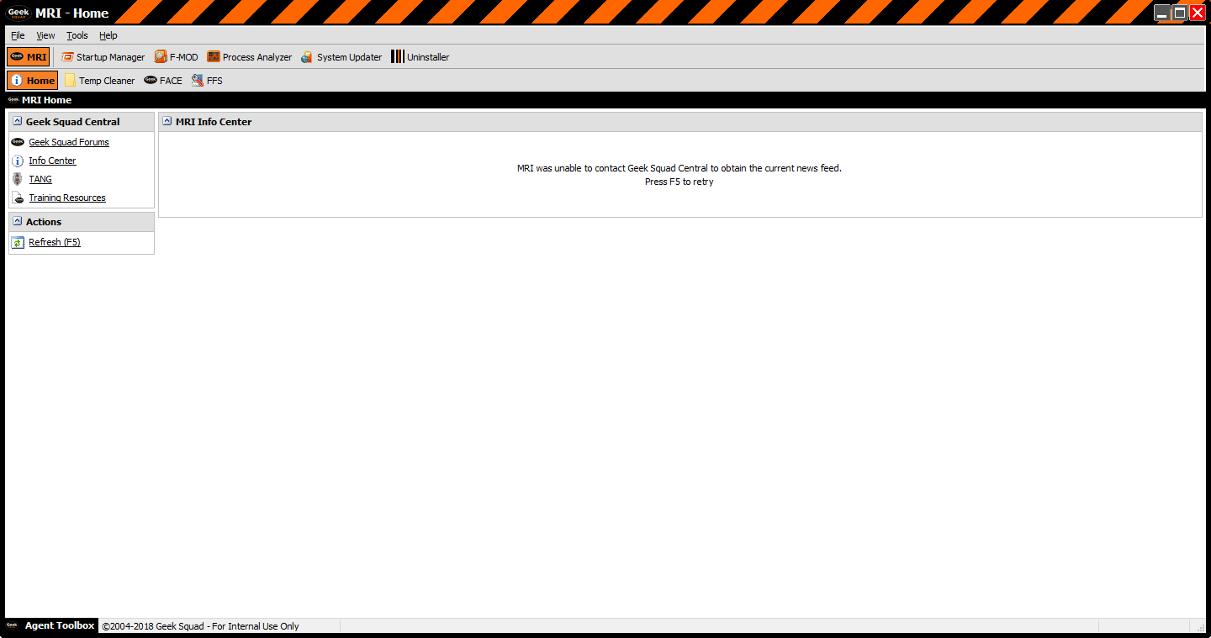

Slide 16
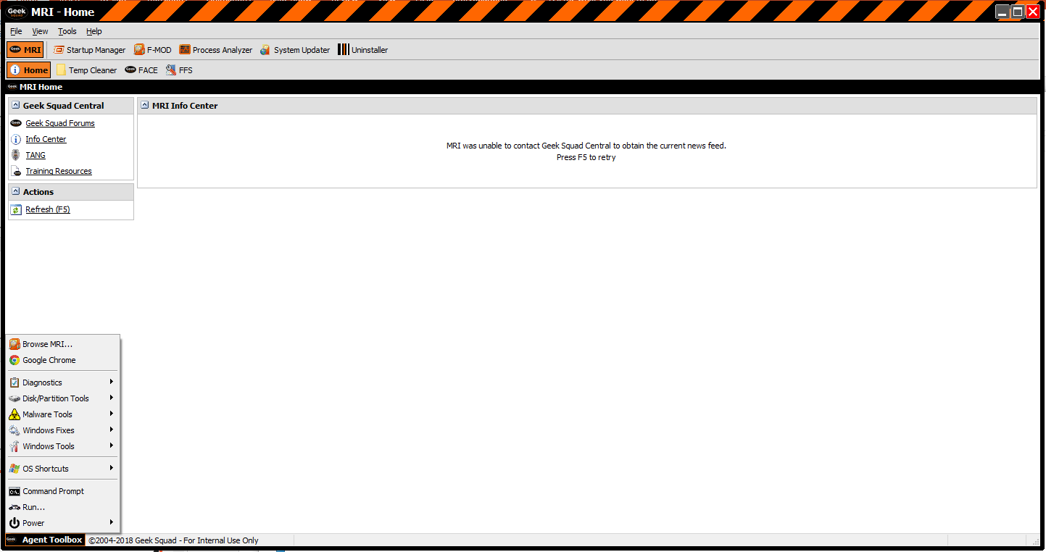

Slide 17

Software Experiences continues..
This application contains a verse suite of
potential software needed to do any
type of software repair. Such as:
-Virus scanners
-OS services repairs
-Registry fixes
-External Browser to fix hijacked browsers
-Diagnostic tools

Slide 18
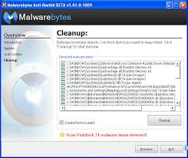
Software Experiences continues..
The strongest part of the application,
in terms of repair, is that MRI has a
bootable OS that allows the computer
to boot outside of its normal OS, while
still having access to the units OS.
It allows Windows to bind to the MRI
OS to allow access to things, such as:
- All data on the HDD to allow for back
ups even if the OS is unstable
-In-depth virus scans
-Rootkit scans

Slide 19
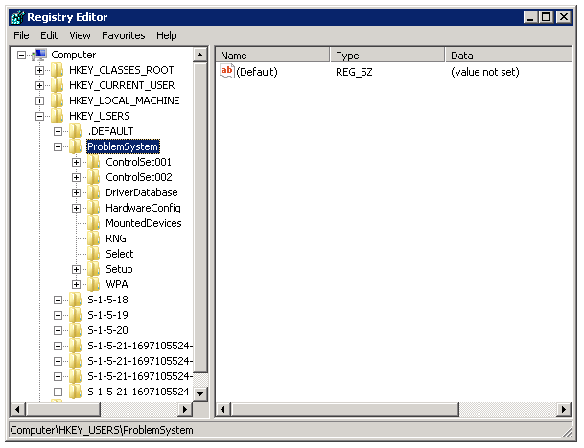
Software Experiences continues..
As well, MRI allows access to the unit’s
OS in an unbinded manner which allows:
- Manual Registry Rollbacks
- Such as a Hive Rollbacks to fix
boot issues
Local Password resets
For example: Hive rollbacks would be used
to remove start up passwords set in the
OS by malicious software or remote
access scams.
(pic of start up password)

Slide 20
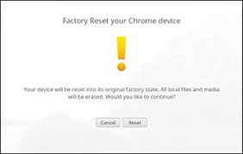
Software Experiences continues..
Working in operating systems like MacOS
and Windows allows for large scale repairs,
like registry and services repairs.
However an OS such as ChromeOS is
designed for quick simple fixes. A
Chromebook is not meant to store any data
locally on the machine which allows for
quick restores called Powerwashing. This
process is a full system restore that takes
approximately one minute.
(pic of power wash)

Slide 21
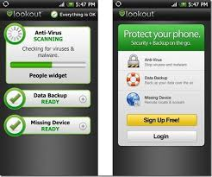
Software Experiences continues..
Similarly to ChromeOS, mobile operating
systems like iOS and Android are easily
fix through system restores.
However since phone have become so vital
to every day life they have become a target
for viruses. (Yes its possible for malware,
rootkits, and viruses to hit our phones).
This has led to development of repair tools
for these devices. Such as:
- Virus scanners
- Rootkit scanners
- Full System diagnostics

Slide 22
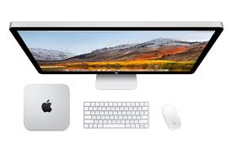
Software Experiences continues..
For example Apple has been working with
Geek Squad to allow us to perform similar
repairs as the Apple stores. For example:
- We have a Mac Mini that allows for a iPhone
to be connected to do a plethora of repairs,
such as in-depth system diagnostics or
image back ups to allow for a system restore
without the user having to lose any data.

Slide 23
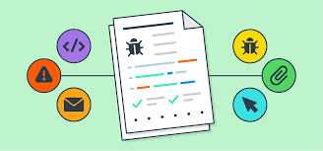

Pursuing additional training
After I was fully trained and use to my position
I started pursuing additional work, such as:
- Bug Reporting to the Development Team
- Work System Optimization
- Leadership Development

Slide 24
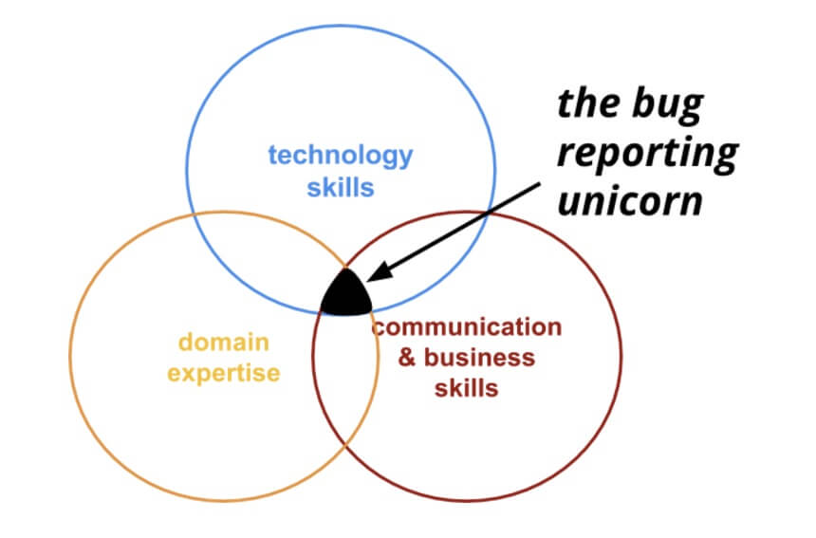
Bug Reports
I took it upon myself to learn how to properly
report bugs, that I experienced during work,
to the development team.
However the official bug report I was unable
to take a screenshot of due to the sensitive
company information that is located on the
forms.

Slide 25
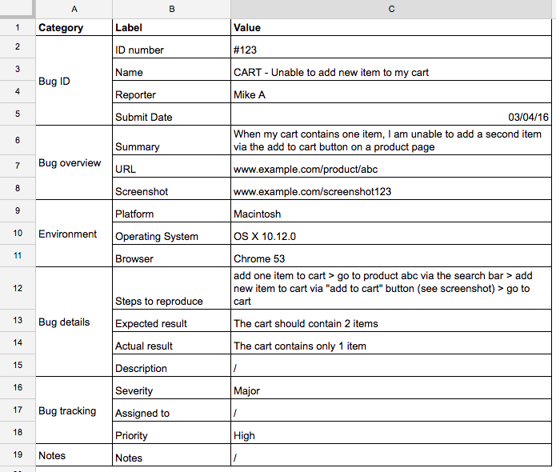
Bug Reporting continued…
The official bug report is an in-depth form that
asks a series of questions required by the
development team in order to properly debug
the software.
Information such as:
- Which program was the bug in?
- What OS was running when the bug was
experienced?
- What back ground programs were running?
- Was the bug repeatable?
Just an example of bug report,
not Geek Squads.

Slide 26
Bug Reporting continued…
During my bug reporting, I was repeatedly
contacted by the development team.
Whether it was simply a thank you for the
report or for further questions about the
bug.
This lead to further work like conference
calls with my team, and members of the
Development team. Or screen sharing with
a specific member in order to show them
what I was able to experience.
This lead to my team being assigned to
Beta test upcoming software and file
correct and precise reports to help out
heir team.

Slide 27
Bug Reporting continued…
This part of the job is very applicable to my
career path so I took grave interest in it.
My coworkers and I have been flown out
and shown the complex where the
Developers are.
This lead to close relations with lead
developers and managers, that I am hoping
will lead to a job for me once I graduate this
Quarter.

Slide 28

Work System Optimization
During my time with Geek Squad, I was looked to as a problem solver. My manager would ask for me to solve/fix systems that we not as efficient as we would like.
The challenge was that not all of these systems were isolated to my individual team. This would also require me to discuss and train members of other teams as well.

Slide 29
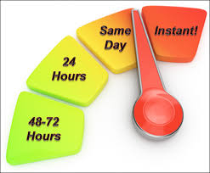
Turn Time
Turn time is a time measurement that starts the moment that a client drops off a unit with Geek Squad and ends the moment I call them to tell them that its ready.
The goal for the turn time is dynamically changing due to the number of units that would be in the store at any given time.
The average goal for turn time that I experienced was ~2 days.

Slide 30

Turn Time continued…
When I first started with Geek Squad my store was averaging a 2-3day turn time month to month.
This was, in my opinion, abnormally slow. Because I was able to complete units after a single day if not shorter.
So I developed a list of steps at are required for the average computer repair. Breaking them into sections to be completed together.
This system would then lower our average turn time from 2-3days to 0.75-1 day.

Slide 31

Shipping Products
Whenever a computer comes in that is physically damaged we would have to send the unit out to a specific service center to have it fixed. Usually because we can’t get the parts in the store.
This process was very messy and was being managed by two teams in the store to send the units out.
So I was able to have it managed completely by a single team, which increased the rate at which it was being completed.

Slide 32
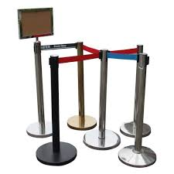
Queue Line Management
When a client comes into the store to visit Geek Squad, usually they end up waiting ~20 minutes.
This obviously would anger people because no one likes waiting extended periods of time.
I was able to work with my manager to establish a effective way to queue the lines with walk in appointments that were handled in between our already scheduled appointments.

Slide 33
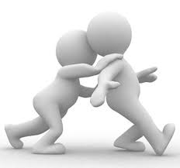
Leadership Development
Since I was always in charge of the problem solving, I naturally had to teach/train my coworkers in the systems that I would be developing.
This was scary at first, but I was being encourage, or pushed, by my manager to embrace it and use it as training for my later careers.
So I did…

Slide 34

Leadership continued…
For example: With the system I developed for the turn time optimization. I would have to communicate effectively why my system is better then the one my coworkers have been using for years prior. Eventually I was able to discuss each step, why its important, and establish how it will fix our issues without causing any more issues.
This would lead to the development of my leadership reputation among my team and my store.

Slide 35

Leadership continued…
This was so successful that my manager had me go to a district meeting and give a presentation on this system.
At this meeting, I was presenting in front of 15 different Geek Squad Managers, and about 1 or 2 of their repair agents from their store. After the presentation, I was approached by several and asked to go to their store for a couple days in order to fully establish this system.

Slide 36

Looking toward the future
I am very grateful for my time with Geek Squad. It has led me to a very professional level and taught me skills that will follow me to the rest of my career.
Like I mentioned, I will be looking to move further with the company to the development team after I graduate.
Hopefully I am able to work for that team, if not I will pursue my career outside of the company. But will always enjoy my time here.

Slide 37

The End…
And that was my time at Geek Squad…
Thank You!

